Slide 1
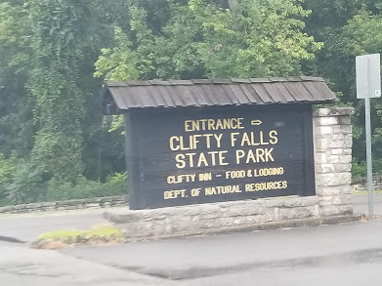
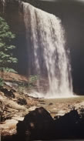
VVV 2018 REUNION near Madison, Indiana

Slide 2
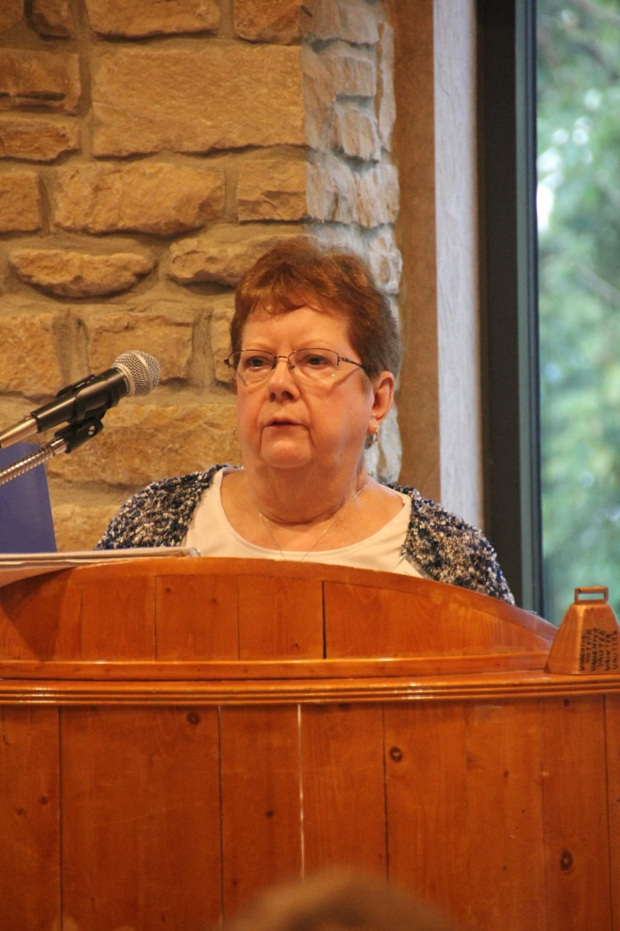
Bonita Welch, the hostest with the mostest!!
Bonita had everything planned, including meals, trips to cemeteries and handouts telling about our ancestors. Thanks for everything from your grateful cousins.
(Well, Darren and Tom helped also !)

Slide 3
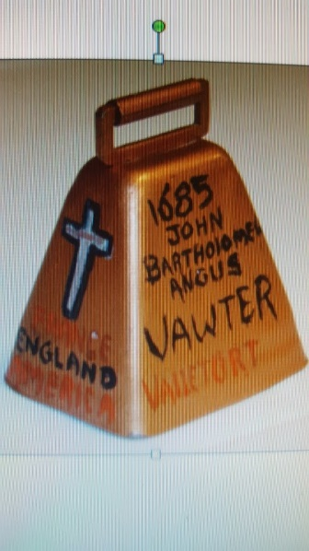
In keeping with tradition, the youngest person at the reunion rings the old bell to open the meeting. The honor this year went to Michael Smith, who is shown here with his mother, Jacqueline Hudson Smith.

Slide 4
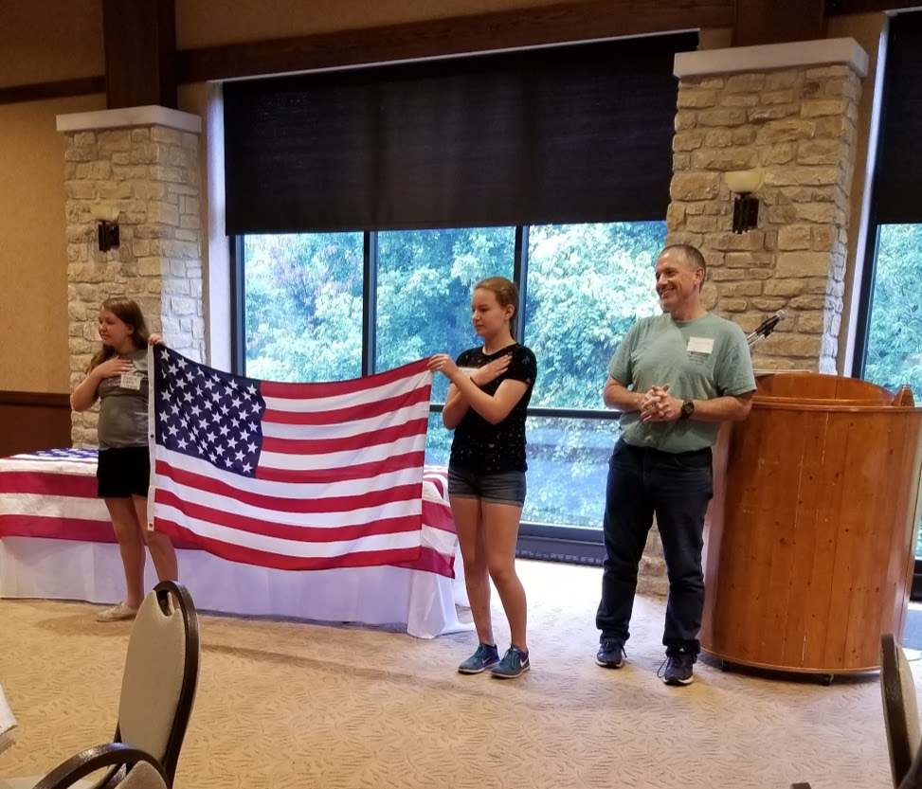
No flag pole this year, so President Darren Welch drafted some helpers.

Slide 5
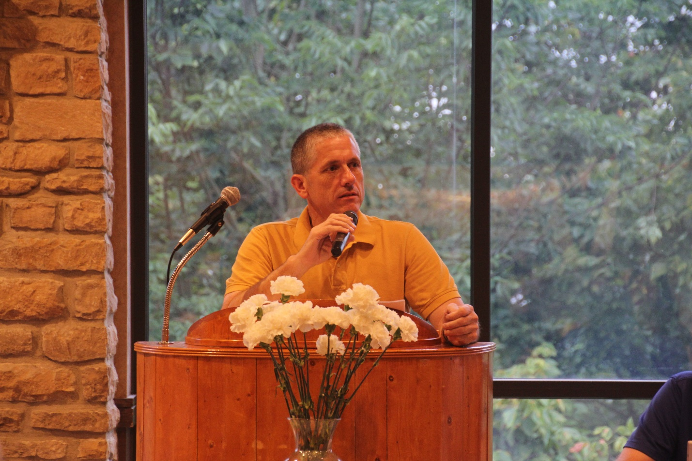
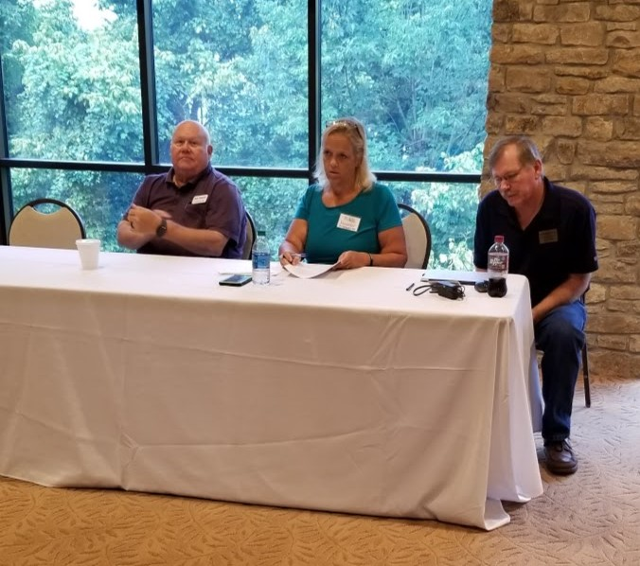
Vice-president, Robert L (Bob) Vawter,
secretary, Michelle Alexander,
treasurer, Jordan Johnston
Bob will be the president for the next two years.
President, Darren Welch

Slide 6
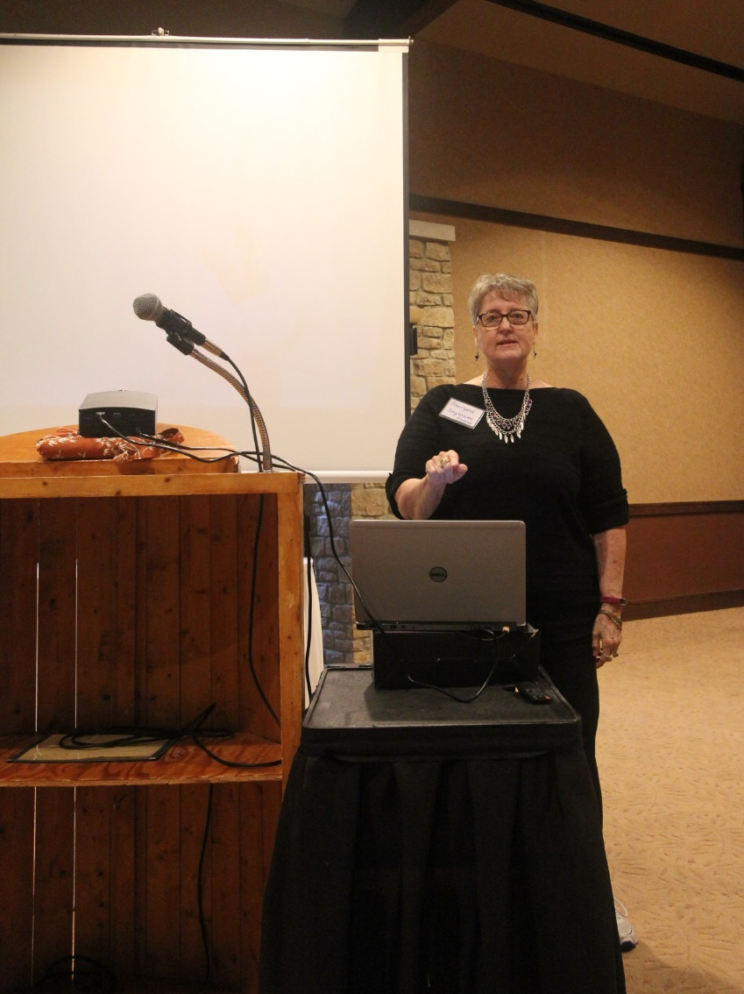
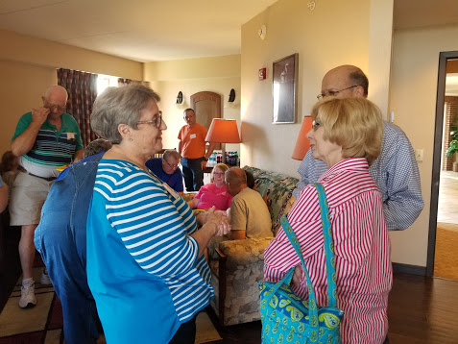
Here Georgene is visiting with Jan and Jon Mauch. This is the first VVV Reunion for them. (This is in Bonita’s suite.)
Georgene Jurgenson gave a very interesting genealogy presentation about our Indiana Ancestors.

Slide 7
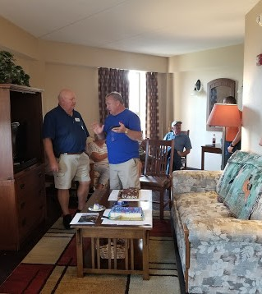
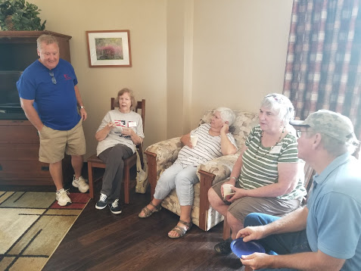
Bonita hosted an informal get together on Thursday night. Here Bob Vawter, Michael McNary, Patricia Renton, Pam Elsass, Becky Guinagh and Jordan Johnston, among others, are just visiting.

Slide 8
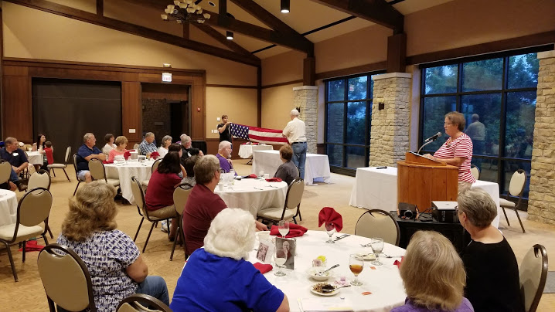
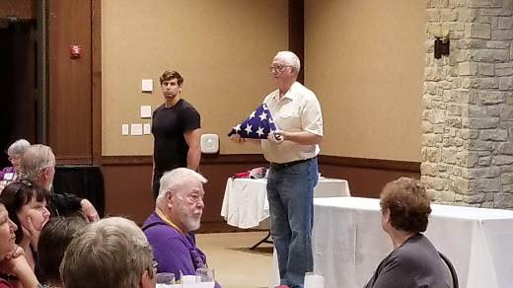
Jerry Beasley and Frederick Cummings demonstrated how to fold an American flag. Each fold has a special meaning, as Shirley Beasley explained.

Slide 9
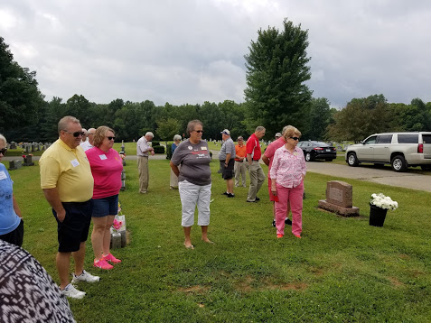
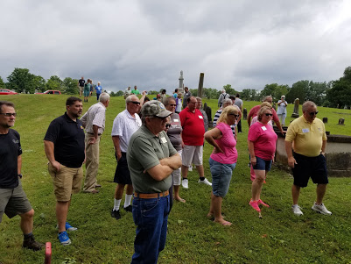
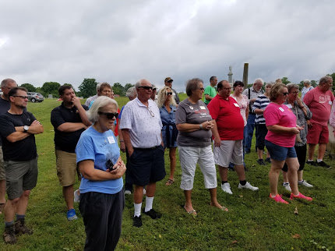
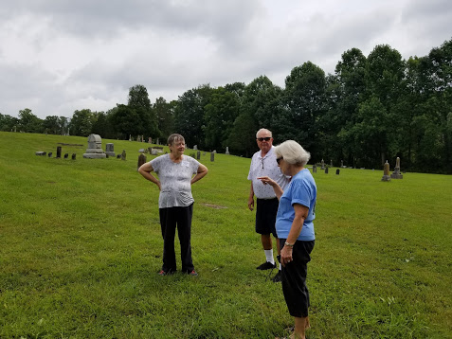
Saturday, we visited several cemeteries.
The first was the
Vernon Cemetery

Slide 10
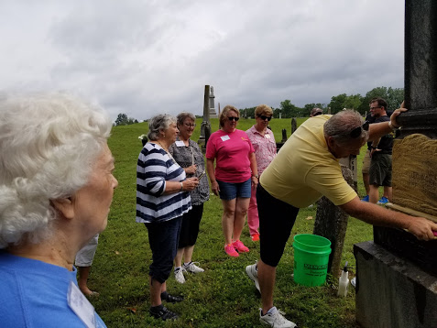
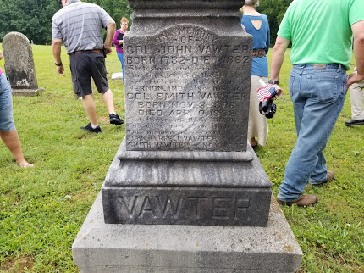
Mike McNary gave John Vawter’s monument a good scrubbing.

Slide 11
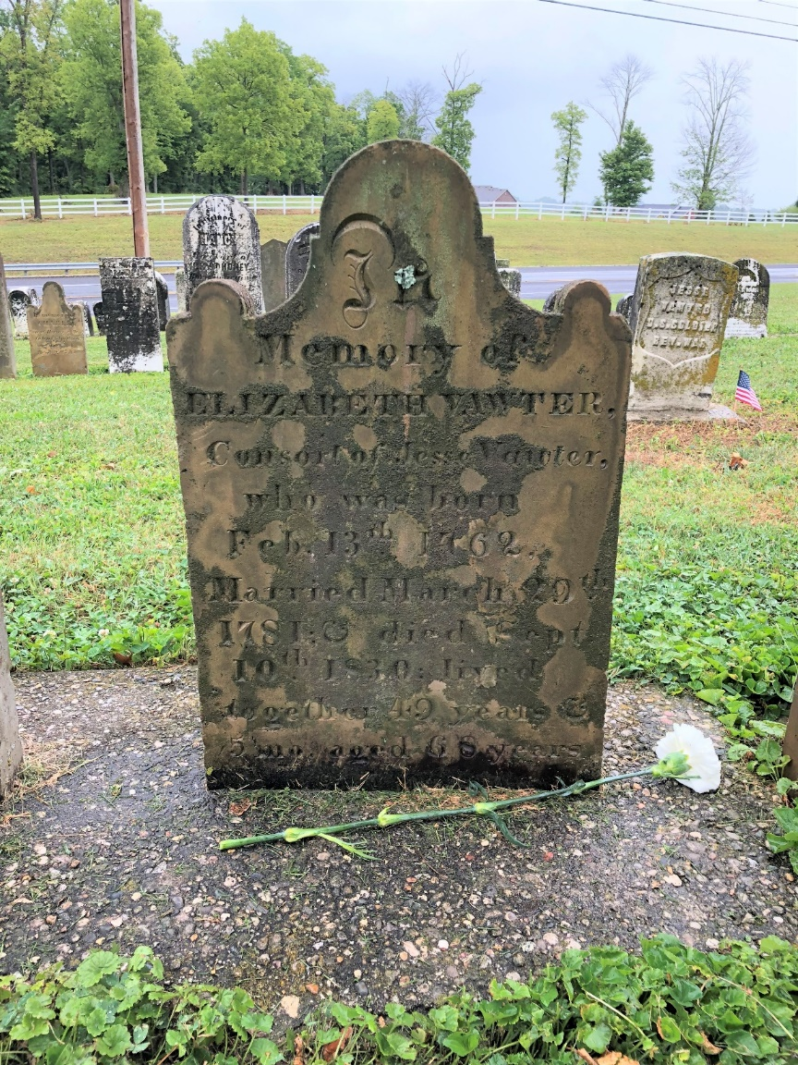
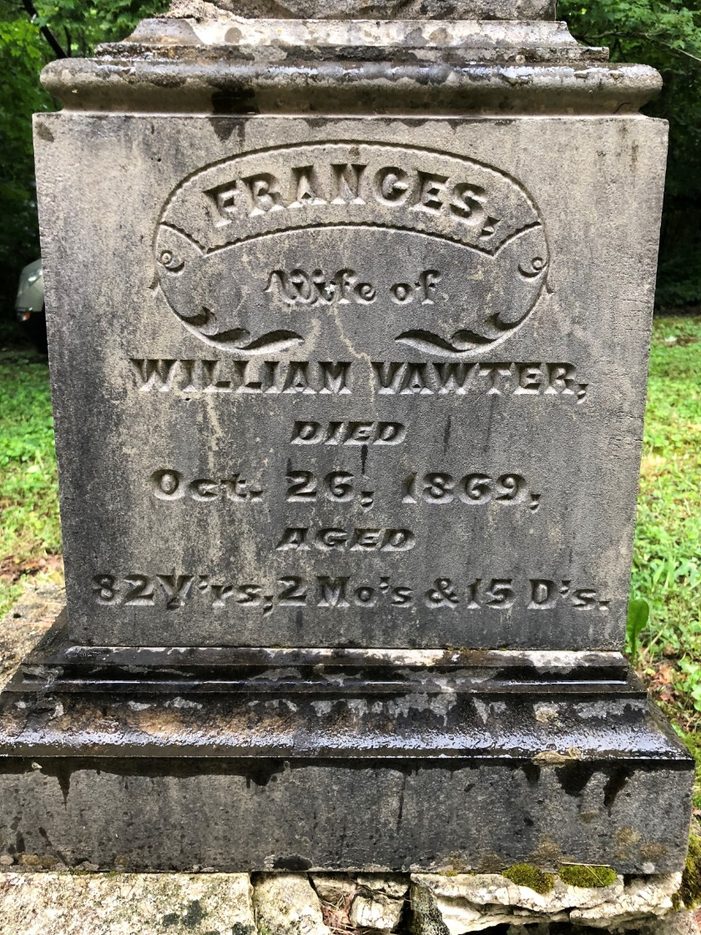

Slide 12
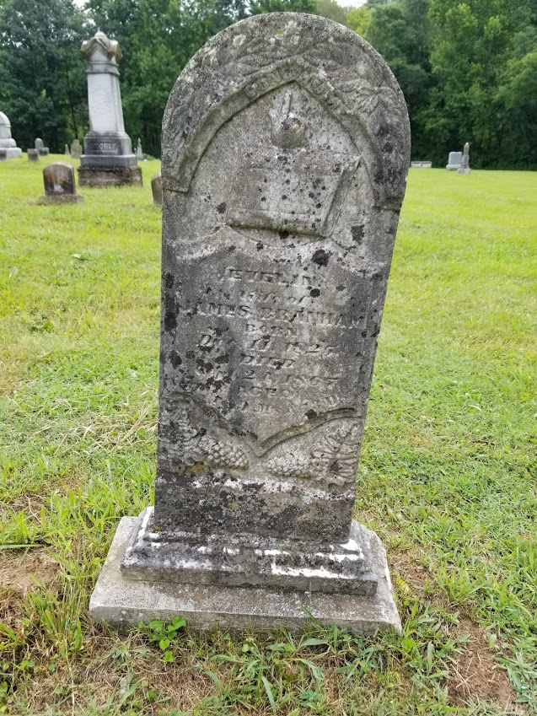
Many of the old stones are so hard to read.
Eveline Adams married James Branham. He was the son of John Branham and Frances Vawter.
Eveline – 1825 – 1867
James – 1816 - 1872

Slide 13
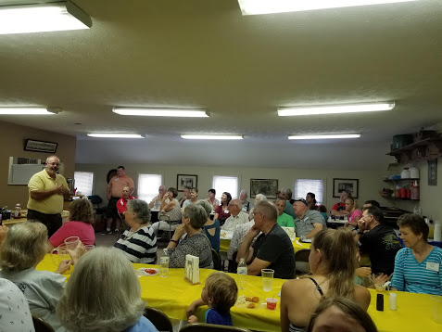
Lunch was provided by the nice folks at the Jennings County Historical Society. And Mayor Don welcomed us.

Slide 14
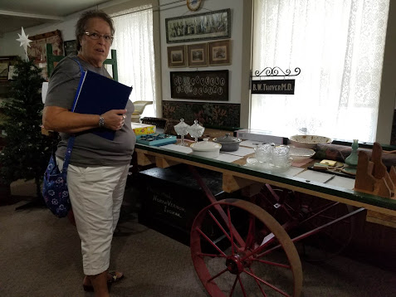
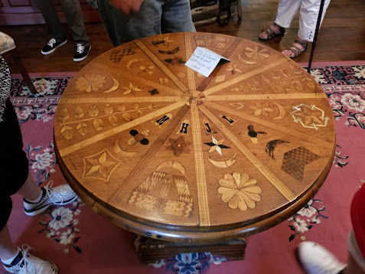
The Jennings County Historical Society has a house full of tons of memorabilia.
Here Shirley Beasley is looking over some of the items. The table has over 70 different types of wood.

Slide 15
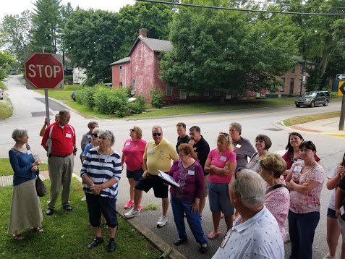
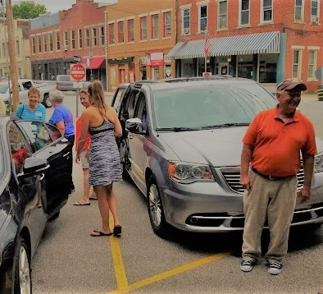
After lunch, a walking tour of downtown.
Tom Taylor (right) also helped with the reunion. He is Bonita’s brother.

Slide 16
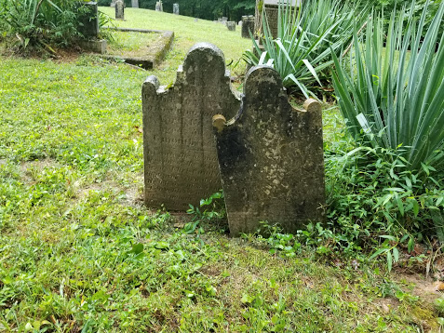
And then on to the Vawter-Summerfield cemetery.
The resting place of Philemon and Anna Vawter.
Many other people buried in this cemetery have Vawter connections.
Clarkson, Glover, Feagler, King, Burns, Stott, Grinstead, and Holsclaw, to name a few.

Slide 17
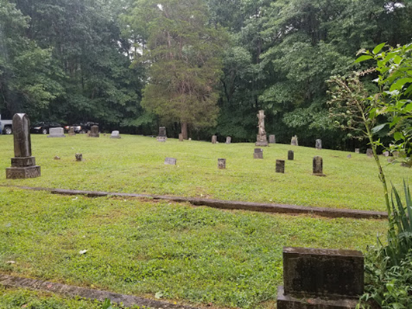
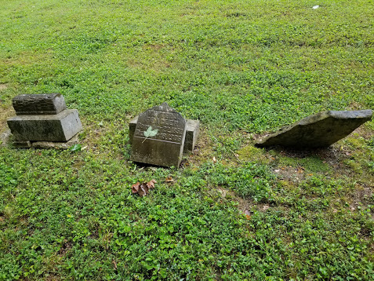
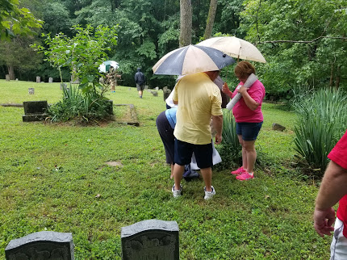
Such a beautiful cemetery, off the beaten trail, for sure. Our visit was cut a little short because of rain.

Slide 18
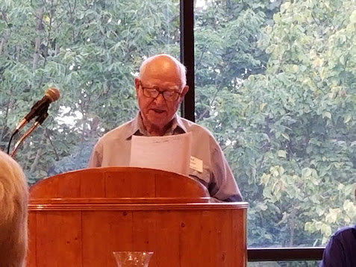
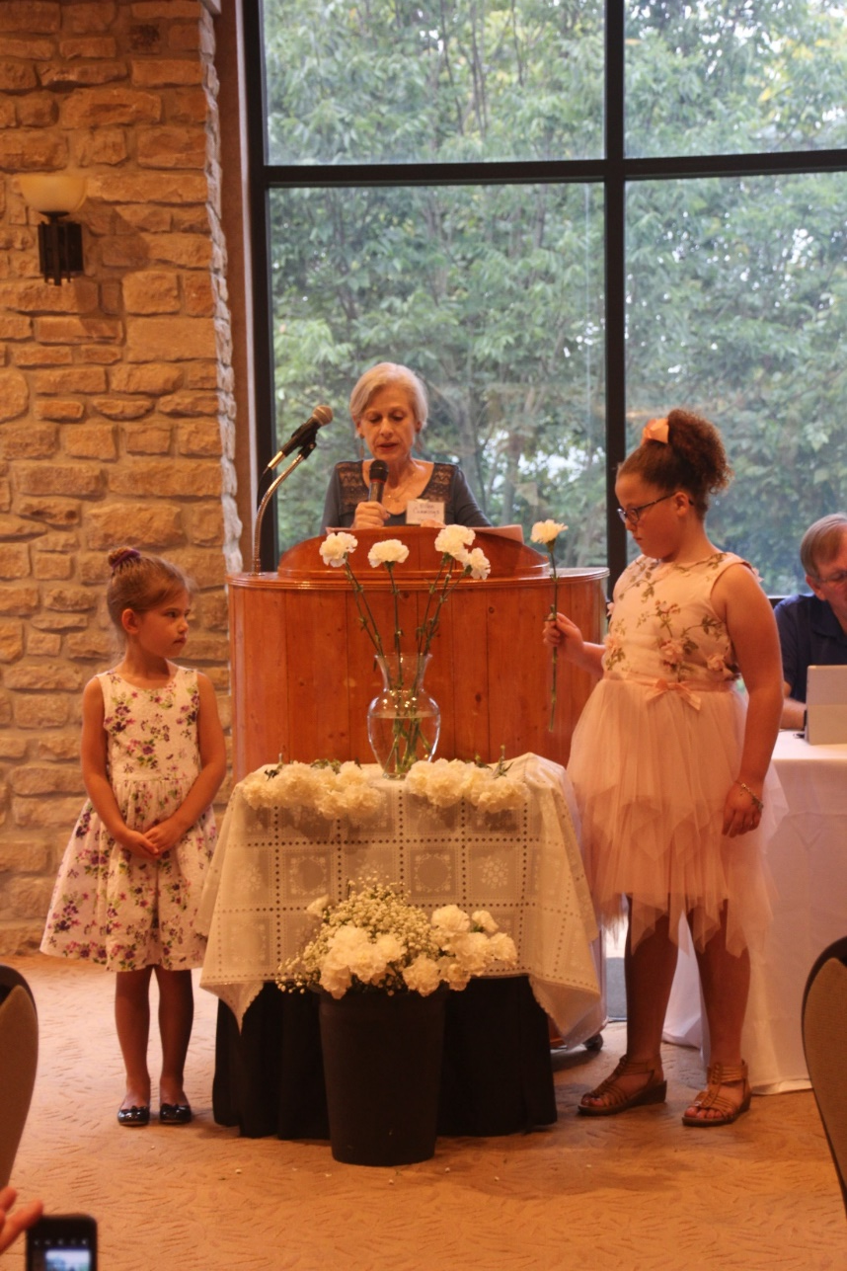
After the buffet meal in the Overlook Room, Fred Wicker and Ellen Wicker Cummings conducted the memorial service.

Slide 19
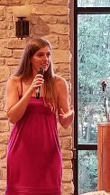
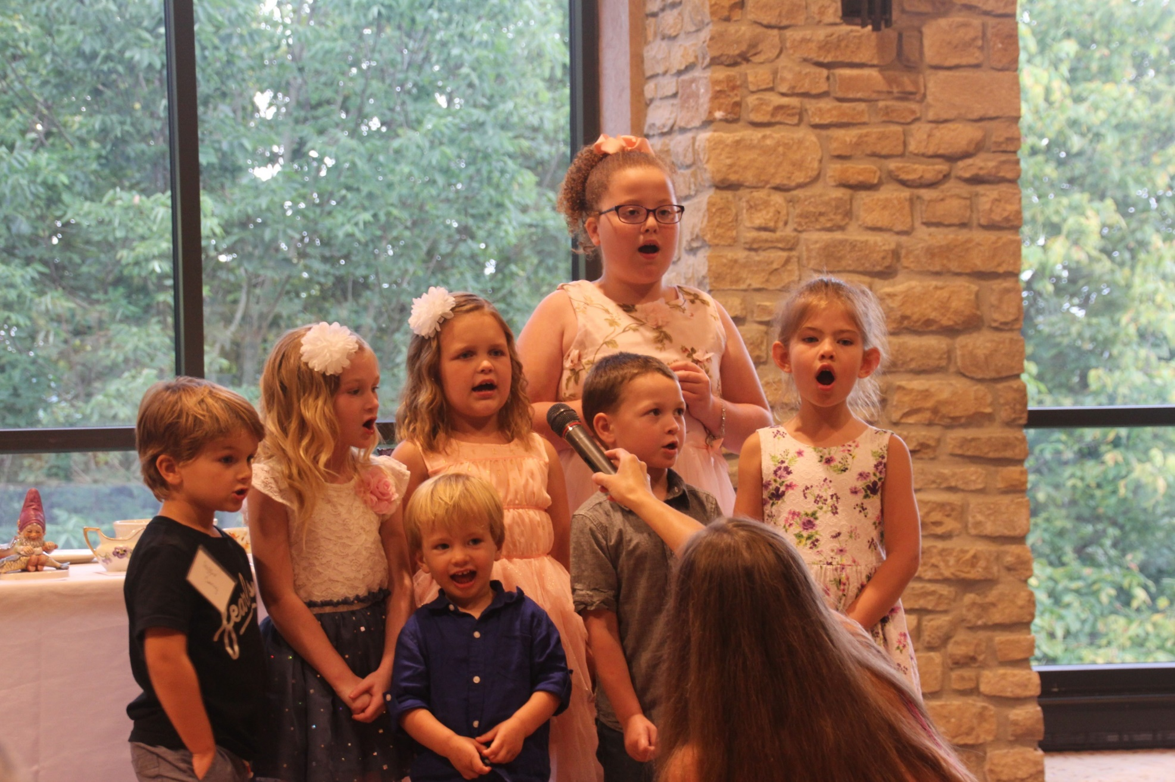
Sarah Aue Palodichuk and some of the children entertained us with their singing.
Amazing job Sarah.

Slide 20
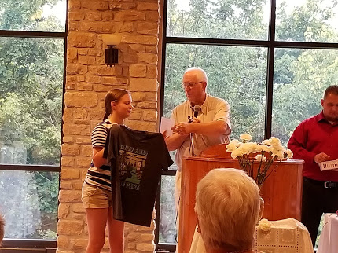
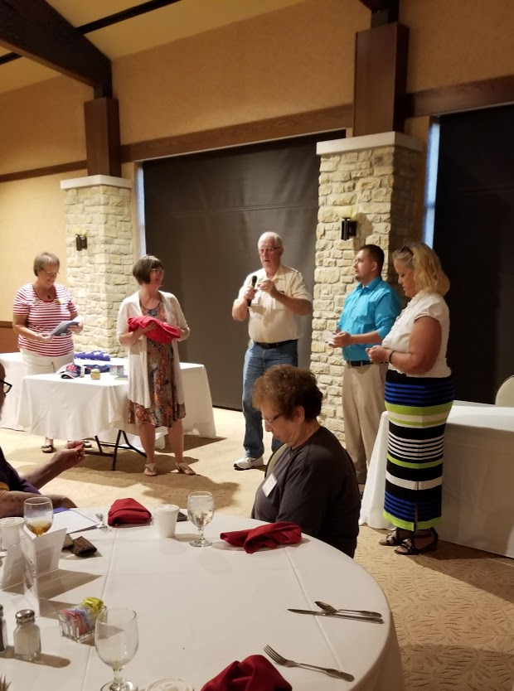
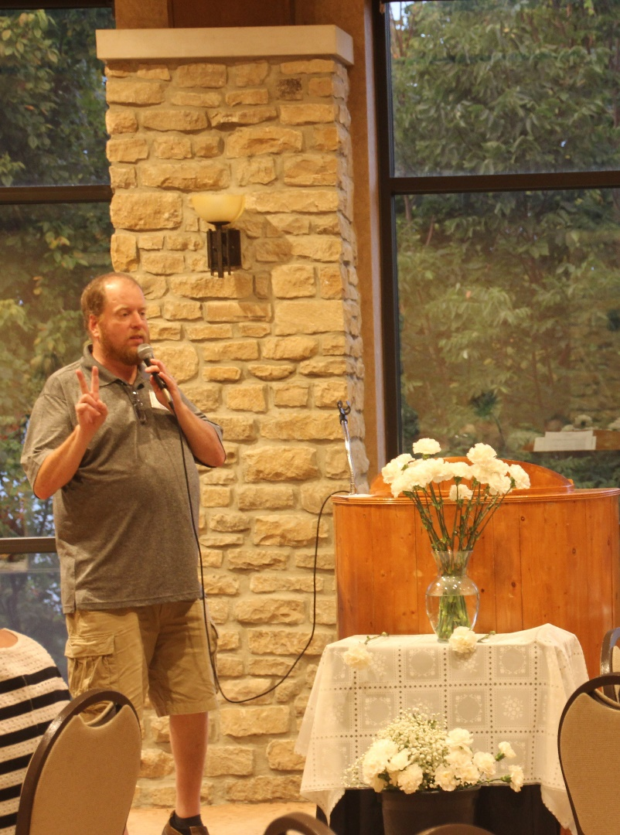
And of course, the door prizes and the auction.
Proceeds from the auction go to the Vauter Church.

Slide 21
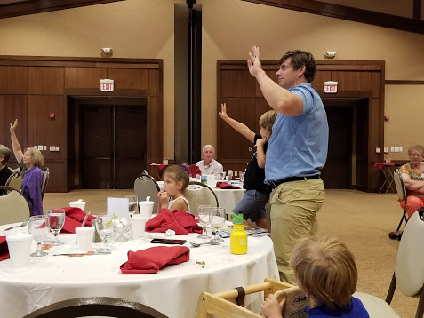
Roll call of states – Indiana won.
Frederick represents Texas now.

Slide 22
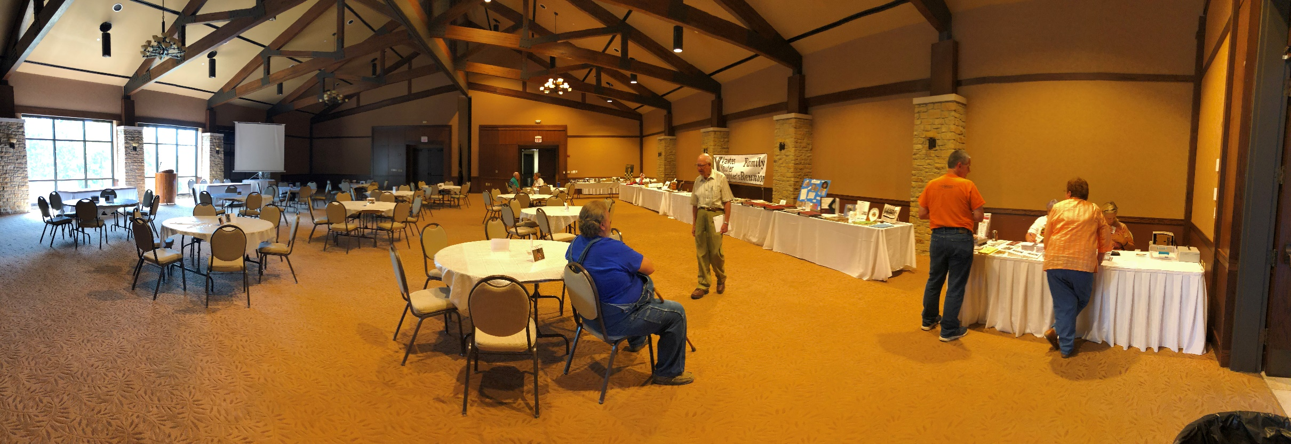
The Overlook room was reserved for the VVV reunion and was a great place for our meetings, meals and all our keepsakes from years past.

Slide 23
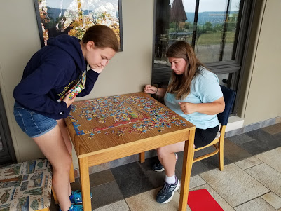
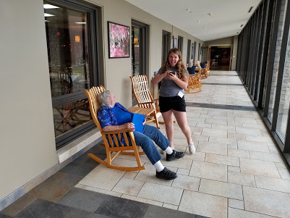
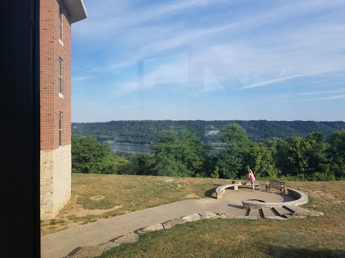
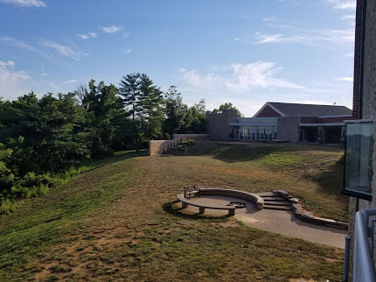
The walkway to the Overlook Room held tables and games.
And the glass outer wall had a beautiful view.

Slide 24
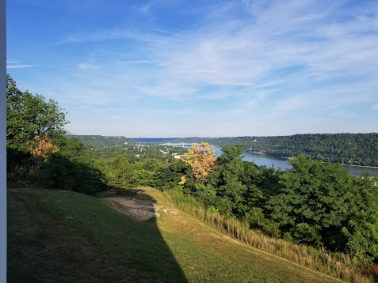
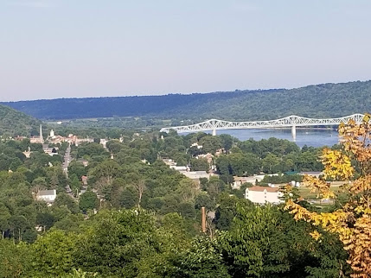
The view from the back of the Inn…..that’s the Ohio River and Kentucky.

Slide 25
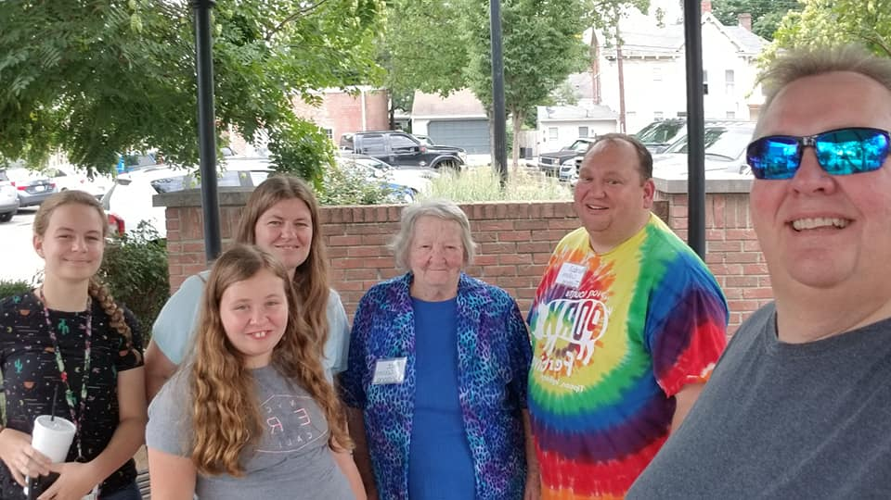
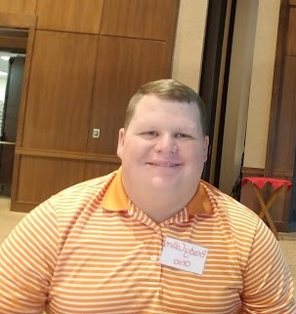
Brad Collins (right) with family, Amanda, Madison, Brooklyn and his mother Alice . Brad provided many of these pictures.
Brady Collins came for part of the reunion.

Slide 26
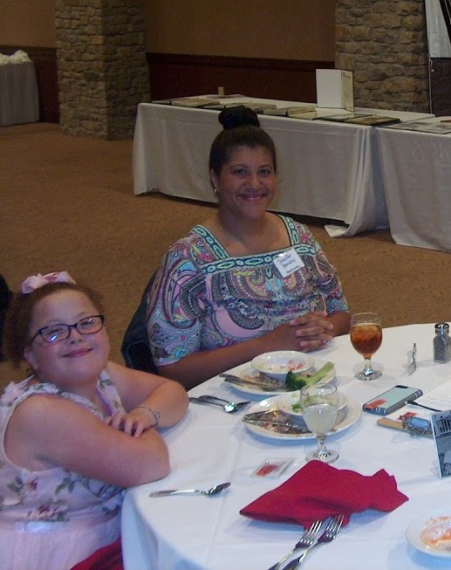
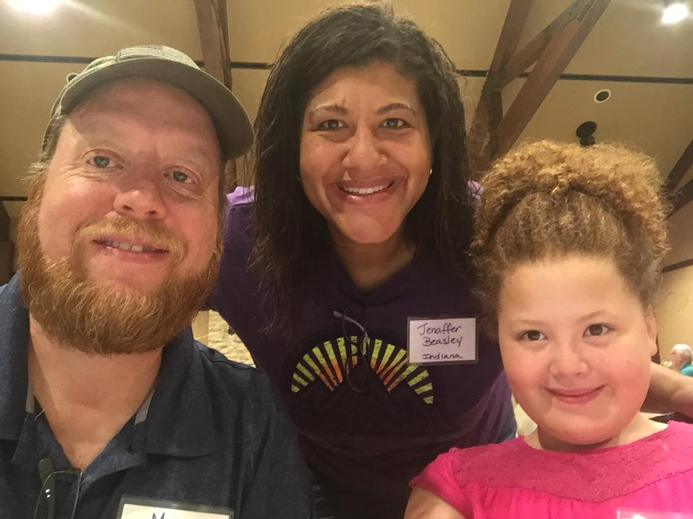
Swiped from facebook. Such a cute picture of Mark, Jenaffer and Karissa Beasley

Slide 31
A nice touch…..a different old picture on each table.

Slide 33
Many thanks for the pictures Brad, Mike, Shirley and Jerry.
See you next year in Kansas.

